Slide 1


Slide 2
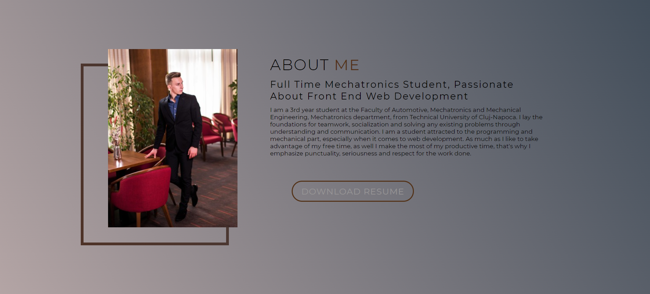

Slide 3
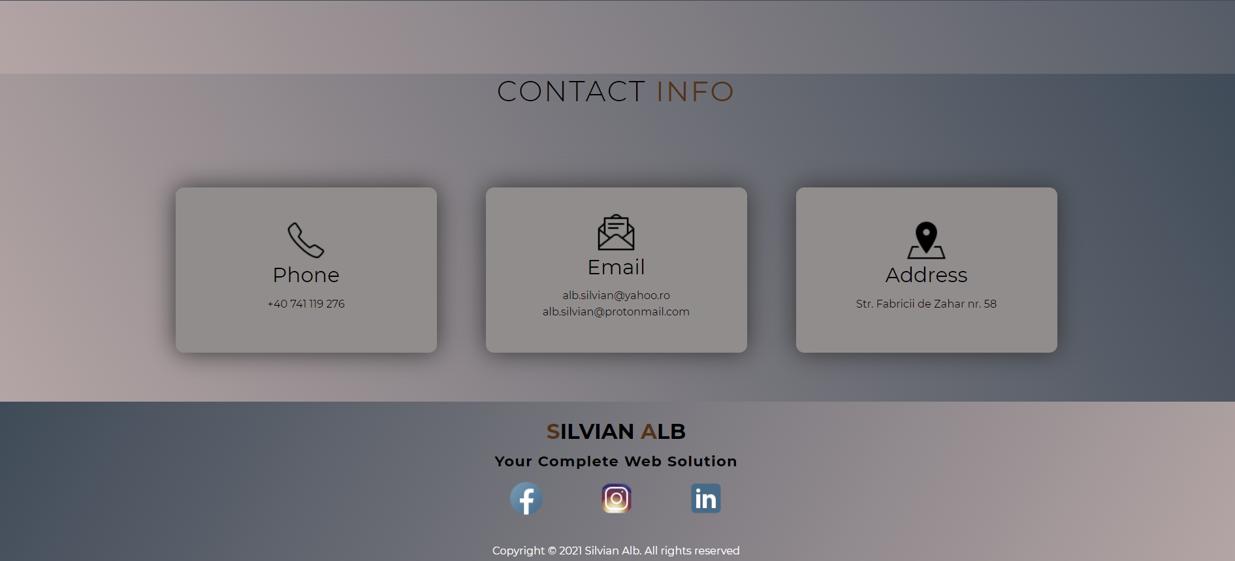

Slide 4
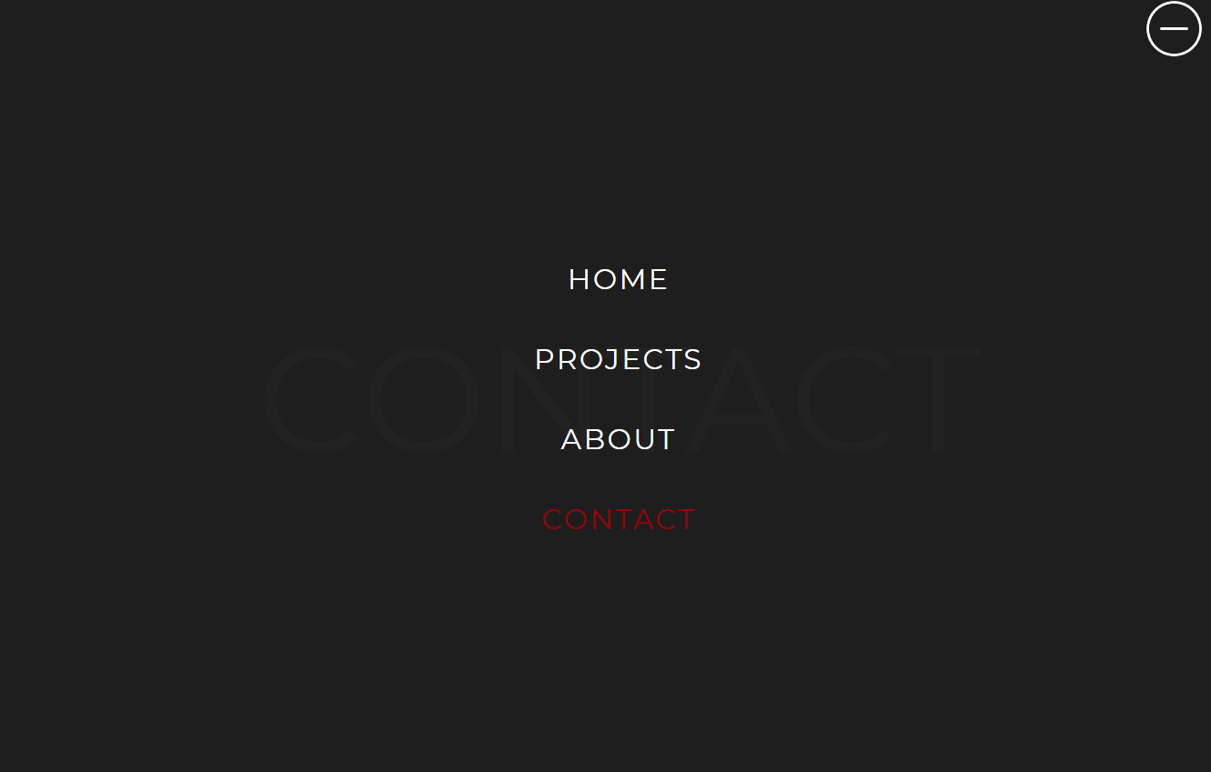

Slide 5
As technology nowadays comes in different shapes and sizes, I created my website so that it maintains its appeal even on a bigger screen but also on a smartphone sized display.

Slide 6
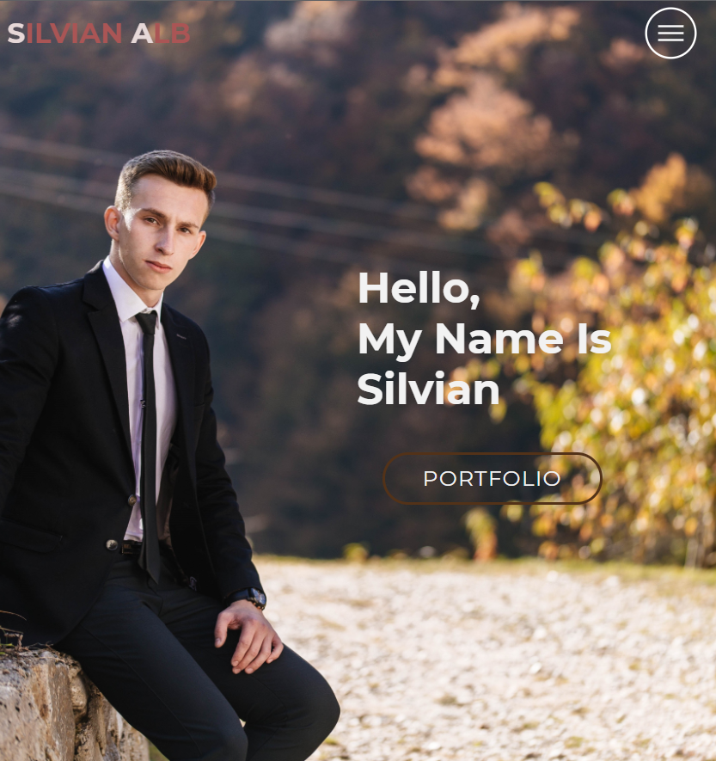

Slide 7
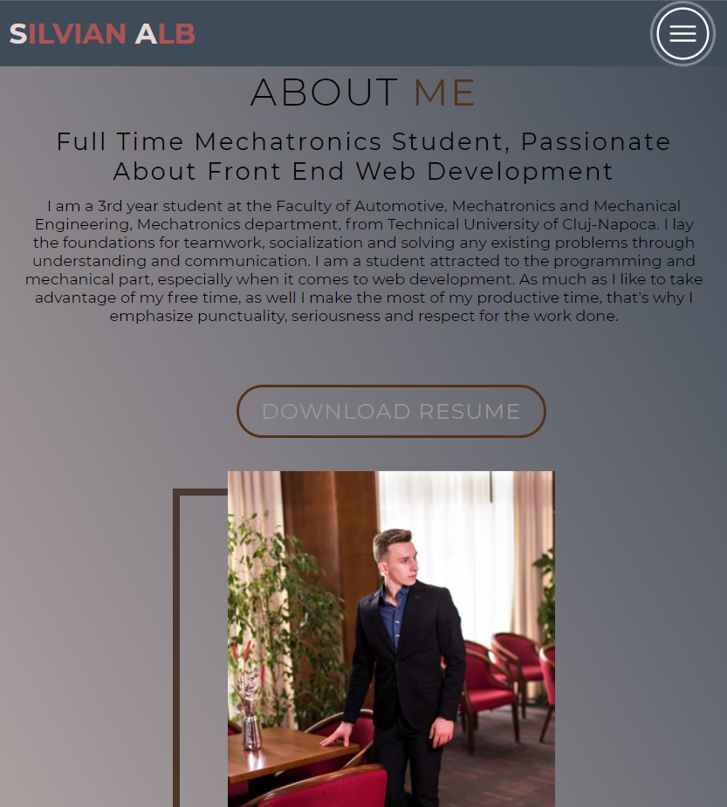

Slide 8
